Slide 1
What's Next?
Android Developer Fundamentals
Lesson 13
This work is licensed under a Creative Commons Attribution-NonCommercial 4.0 International License

Slide 2
13.1 Permissions, performance and security

Slide 3
Contents
Permissions
Performance
Security
This lesson has concepts only. It does not have a practical.

Slide 4
Permissions
This work is licensed under a Creative Commons Attribution-NonCommercial 4.0 International License

Slide 5
Permissions
You have already used permissions in some of your apps:
Permission to connect to the Internet
Permission to use data from a Content Provider
A basic Android application has no permissions so that it cannot do anything that adversely impacts the user experience or data on the device

Slide 6
When to use permissions
App must get permission to do anything that
Uses data or resources that the app did not create
Uses network, hardware, features that do not belong to it
Affects the behavior of the device
Affects the behaviour of other apps
If it isn't yours, get permission!

Slide 7
How apps declare permissions they need
List permissions in the manifest
<uses-permission>
<manifest ...>
<uses-permission android:name="android.permission.READ_CONTACTS" />
<uses-permission android:name="android.permission.READ_CALENDAR" />
<uses-permission android:name="android.permission.CALL_PHONE"/>

Slide 8
Example permissions
ACCESS_COARSE_LOCATION
ACCESS_FINE_LOCATION
ACCESS_NETWORK_STATE
ACCESS_WIFI_STATE
GET_ACCOUNTS
RECEIVE_SMS
CAMERA
RECORD_AUDIO
MODIFY_AUDIO_SETTINGS
ADD_VOICEMAIL
See more at
https://developer.android.com/reference/android/Manifest.permission.html
Notes:
Lots more, these are just examples!

Slide 9
More examples
BLUETOOTH Connect to paired bluetooth devices.
BODY_SENSORS Access data from sensors that the user uses to measure what is happening inside user's body, such as heart rate.
USE_FINGERPRINT Use fingerprint hardware.

Slide 10
Normal and dangerous permissions
Normal permissions do not directly risk the user's privacy
Example: Set the time zone
Android automatically grants normal permissions.
Dangerous permissions give access to user's private data
Example: Read the user's contacts
Android asks user to explicitly grant dangerous permissions
Notes:
Whether a permission is normal or dangerous affects how the permission is granted, we will talk more about this soon

Slide 11
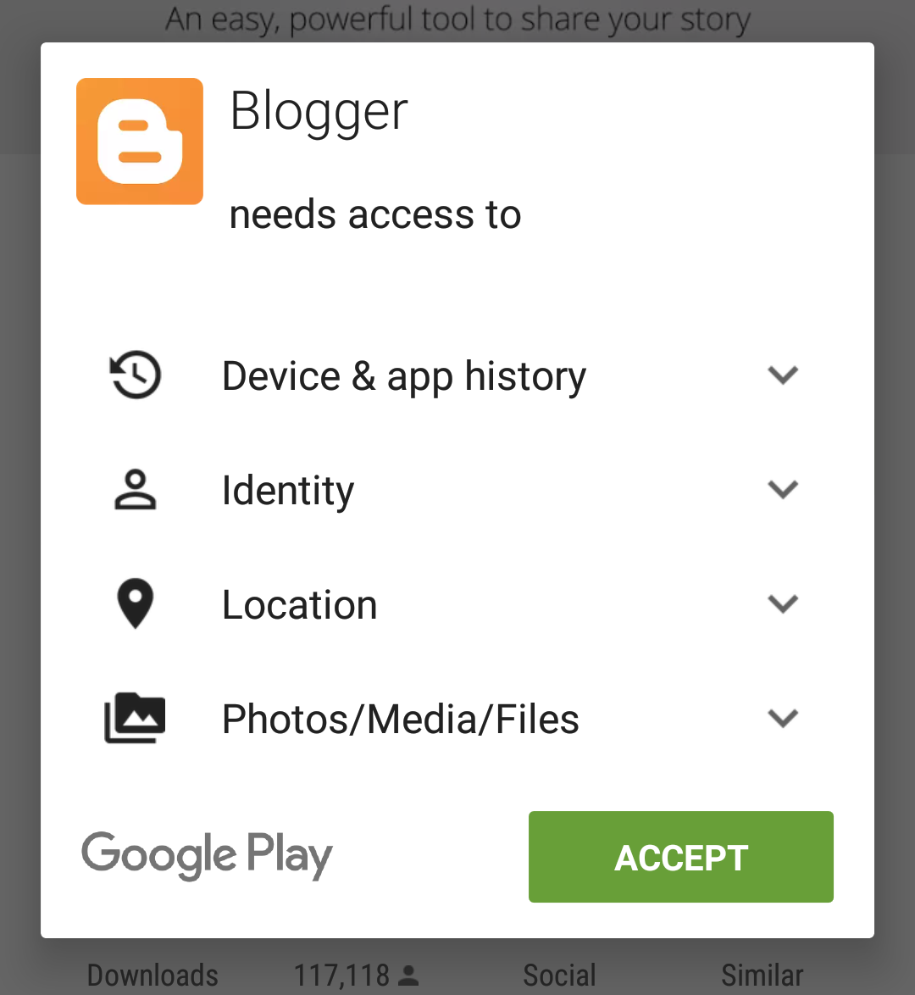
How users grant permission
For apps created before Marshmallow
Users grant permission before installing

Slide 12
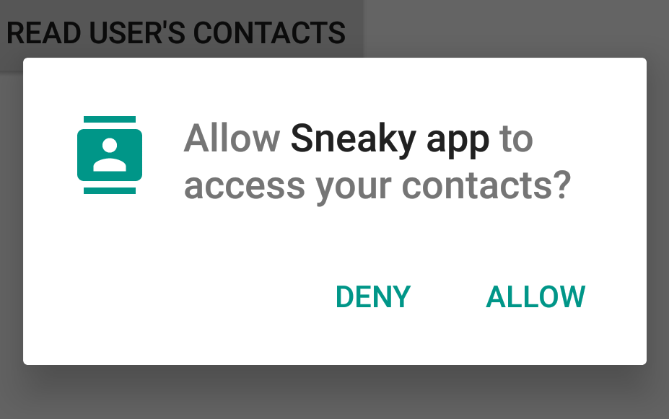
How Users grant permission
Marshmallow onwards
Installation doesn't ask user to give permissions
App must get runtime permission

Slide 13
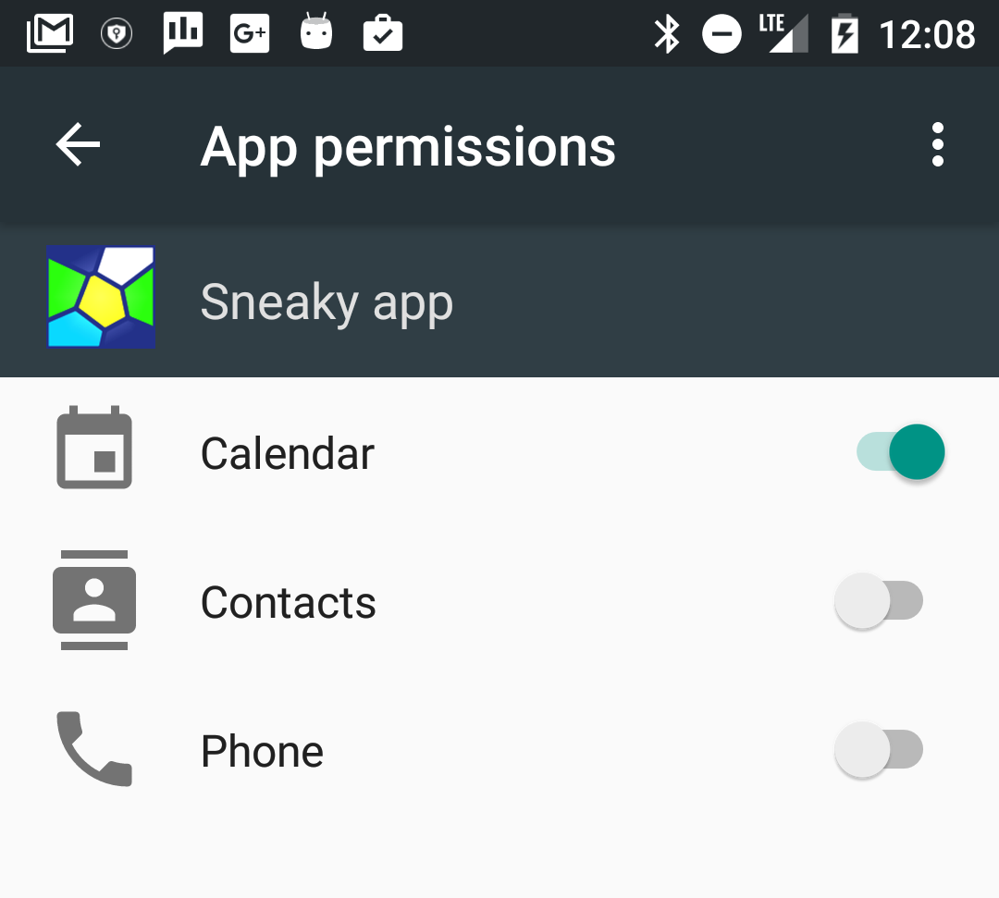
How users revoke permission
Before Marshmallow
Uninstall app!
Marshmallow onwards
Revoke individual permissions
Settings > apps > permissions

Slide 14
Differences in permission models
Before Marshmallow
If app is running, it can assume that user granted permissions during installation
After Marshmallow
App needs to get permission at runtime
Must check if it still has permission every time
User can revoke permissions at any time

Slide 15
Framework versus support library
Android framework 6.0 (API level 23) + provides permission methods
Better to use Android Support Library

Slide 16
Support library permission methods
Support library permission methods check Android version
If runtime permissions model is supported,
requests the appropriate permission from the user
Otherwise, checks if the permission was granted at install time

Slide 17
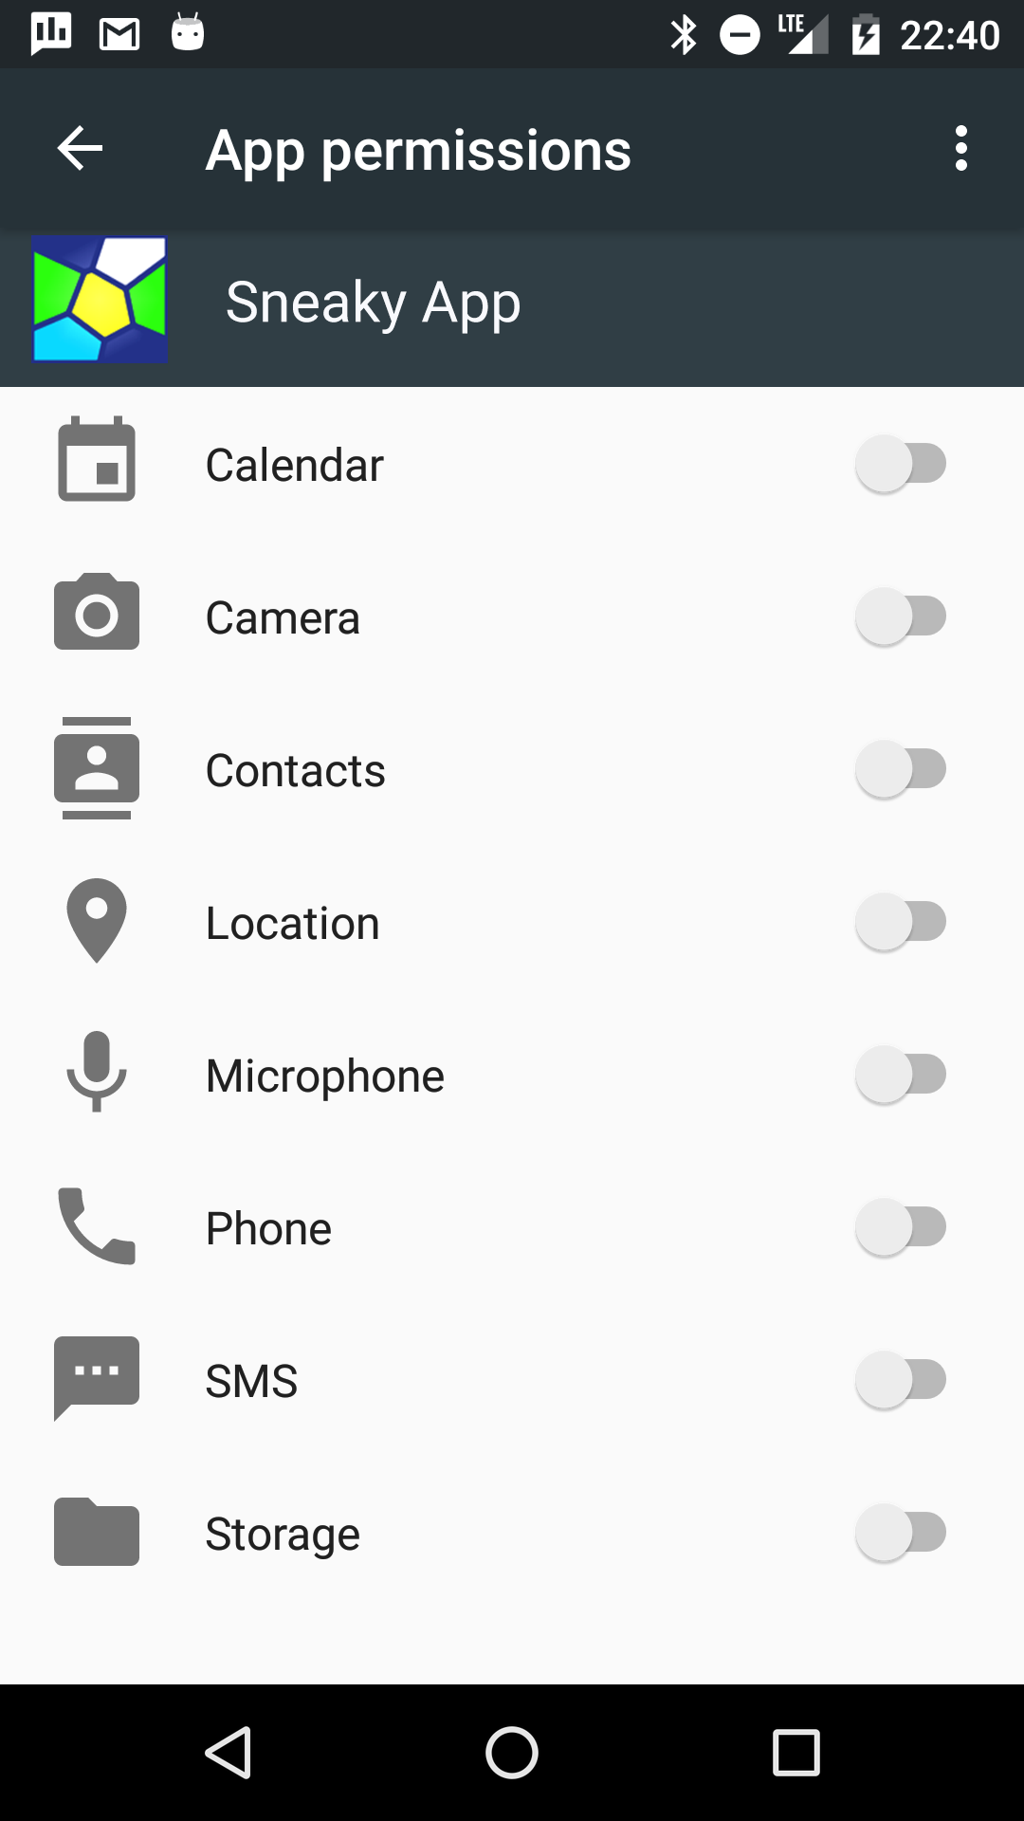
Best practices for permissions
Ask for the least amount of permissions that you need
Don't overwhelm the user
Consider using an Intent instead— For example, send an Intent to use the camera

Slide 18
Learn more about permissions
List of permissions defined in Android: developer.android.com/reference/android/Manifest.permission.html
Permissions in Android: developer.android.com/guide/topics/security/permissions.html
Best practices: developer.android.com/training/permissions/best-practices.html
Blog entry about runtime permissions: android-developers.blogspot.com/2015/08/ building-better-apps-with-runtime.html

Slide 19
App Performance
This work is licensed under a Creative Commons Attribution-NonCommercial 4.0 International License

Slide 20
What is app performance?
Speed
Responsiveness
Smoothness
Consistency
Resource-efficiency

Slide 21
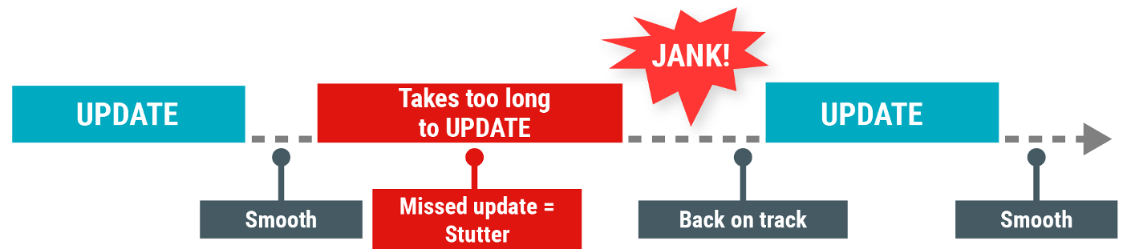
The Main thread must be fast
Hardware updates screen every 16 milliseconds
UI thread has 16 ms to do all its work
If it takes too long, app stutters or hangs
WAIT

Slide 22
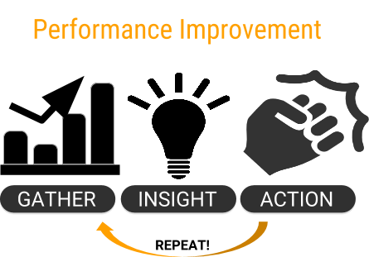
Improving performance
Be systematic
Gather information
Gain insight
Take action
Iterate
Use tools

Slide 23
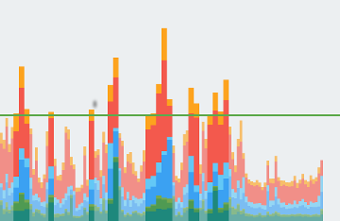
Profile GPU Rendering tool
On your mobile device, go to Settings > Developer Options
In Monitoring section, select Profile GPU Rendering.
In Profile GPU Rendering popup, choose On screen as bars
Go to the app that you want to profile
See the bars at the bottom of the screen

Slide 24
Interpret the bars
One bar represents one screen rendered
If a bar goes above the green line, it took > 16 ms to render
Many bars above the line, or heavy spiking indicate problems
User will see stuttering or inconsistent responsiveness
Analyze the bar and fix problems

Slide 25
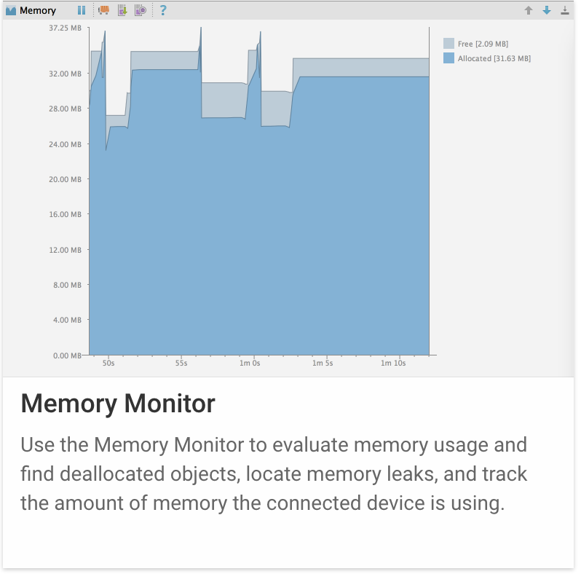
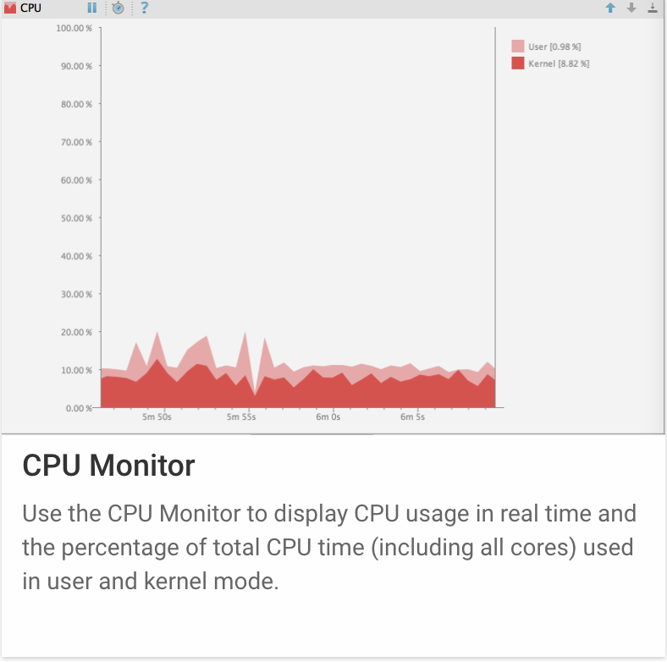
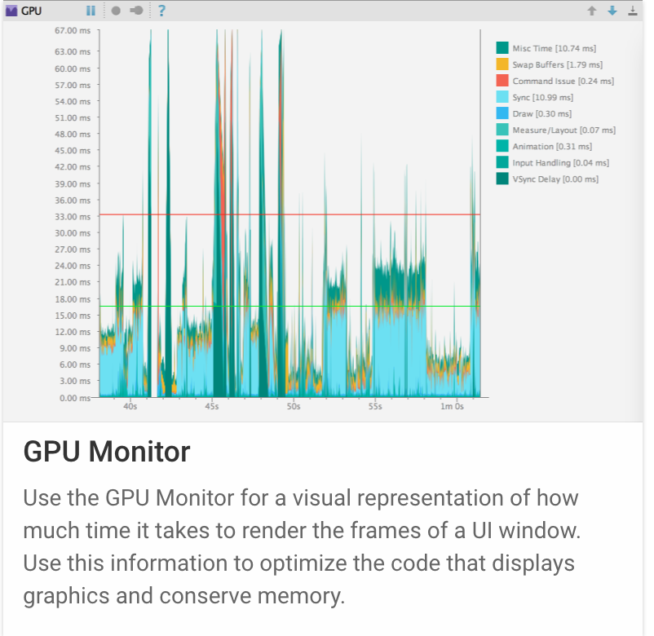
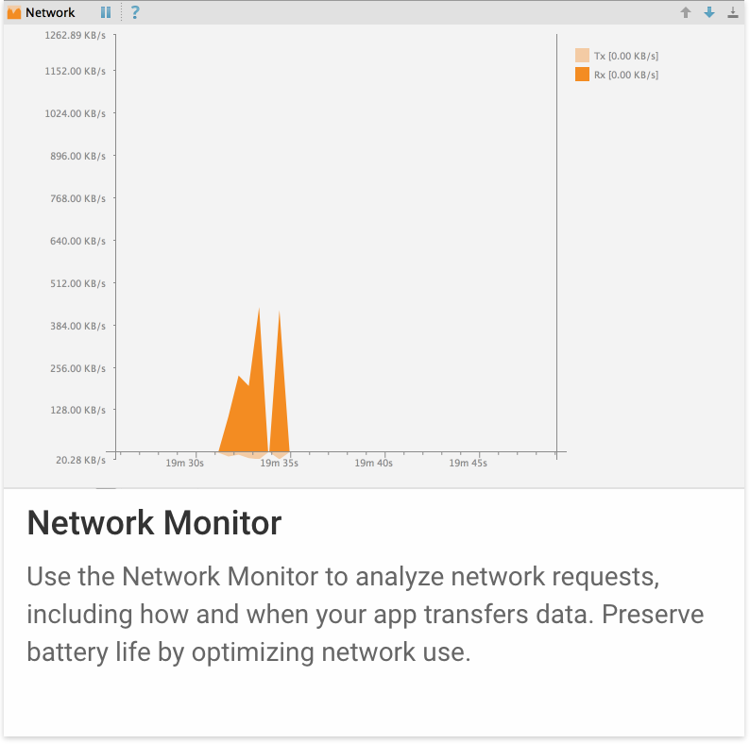
Android Studio > Android Monitor
Memory
CPU
GPU
Network

Slide 26
Don't make users wait
Load data in background
Pre-fetch data
Move work off the UI thread
Optimize UI—draw less and faster
Eliminate overdraw and optimize view hierarchy

Slide 27
Don't waste user's resources
WiFi and mobile radio use lots of battery
Batch requests
Schedule to run when phone is being charged
Large images consume lots of memory
Use smallest images possible
Always use compressed image formats. Use WebP when possible
Getting and putting data on the internet uses up data plans
When possible download data when on WiFi

Slide 28
Learn more about Performance — Introductory
You, Your App and Performance
Exceed the Android Speed Limit
Only Draw What You See
Simplify Complex View Hierarchies
Understanding Compression
Android Performance Patterns (YouTube series)

Slide 29
Learn more about performance — Tools
Profile GPU Rendering Walkthrough
Debug GPU Overdraw Walkthrough
Hierarchy Viewer Walkthrough
Battery Stats and Battery Historian
Android Monitor Overview
Performance Profiling Tools

Slide 30
Learn more about performance — Guides
Analyzing with Profile GPU Rendering
Optimizing for Battery Life
Optimize Memory Use
… and much more

Slide 31
Security Best Practices
This work is licensed under a Creative Commons Attribution-NonCommercial 4.0 International License

Slide 32
Android's got you covered (mostly)
Android has built-in security features
Significantly reduces the frequency and impact of application security issues
You can typically build apps with default system and file permissions

Slide 33

Your app's responsibility
Keep user's private data safe
Do not leak secret things
Treat user's data with integrity
Keep your own app and data safe

Slide 34
Handling user data
Minimize access to sensitive or personal user data
Do not store or transmit user data if possible
But if you must, consider using a hash or non-reversible form of the data
For example, use hash of an email address as a primary key, so you do not store or transmit the email address

Slide 35
Comply with Personal Data Policies
If your app accesses personal information like passwords or usernames, it might need a privacy policy explaining how it uses and stores user data
Notes:
eg UK Data Protection act

Slide 36
Be careful what you log
Android logs are a shared resource, and are available to an application with the READ_LOGS permission
Inappropriate logging of user information could leak user data to other applications

Slide 37
Encrypt sensitive data
Encrypt local files that contain sensitive data
Store the key so it is not accessible by the app For example, use a KeyStore protected with a user password stored off the device

Slide 38
External storage
Do not store sensitive information on external storage
Files created on external storage, such as SD Cards, are globally readable and writable
External storage can be removed by the user
External storage can be modified by any application
Validate input on data from external storage
Notes:
validate user input to protect against malicious injection

Slide 39
IP Networking
Networking on Android is similar to other Linux environments
Minimize network transactions that transmit private data
Use HTTPS over HTTP wherever it's supported on the server
Mobile devices often connect on networks that are not secured, such as public Wi-Fi hotspots
You can implement authenticated, encrypted socket-level communication using the SSLSocket class

Slide 40
Learn more about security in Android
Security tips: developer.android.com/training/articles/security-tips.html
Saving files: developer.android.com/training/basics/data-storage/files.html
Sharing files: developer.android.com/training/secure-file-sharing/index.html
Full disk encryption: source.android.com/security/encryption/

Slide 41
What's Next?
Concept Chapter: 13.1 C Permissions, performance and security
No practical!

Slide 42
END

